Slide 1
FACILITATING RESEARCHER SUCCESS STANDALONE INITIATIVE PROPOSAL – April 23, 2021

Slide 2
FACILITATING RESEARCHER SUCCESS (FRS) STANDALONE INITIATIVE PROPOSAL
Co-Chairs:
Richard J. Reeder, VPR
Nina Maung, AVPR
Initiative Type: Support and growth of federal awards and other R&D Expenditures
Problem Statement:
Current staffing in pre- and post awards insufficient to meet investigator demands
Lean staffing hinder growth, especially for center-scale, multi-investigator proposals
The 2017 FRS study recommended additional FTEs for OPD and OSP/OGM, but were not provided. Same need emerged independently in Strategic Budget Initiative
Opportunity: Add 8 FTE in staged approach to expand research growth

Slide 3
Overview of Sponsored Programs, Grant Management & Proposal Development
RF Activity Overview
Unit in OVPR | FTE | Activity (Annually)
Office of Sponsored Programs, OSP (pre-award) Office of Grants Management, OGM (post-award) | 37 | 2,200 awards, 1,600 proposals $249 M expenditures
Office of Proposal Development, OPD (proposal development) | 5 | 50 proposals (20 large/complex; 30 early career)

Slide 4
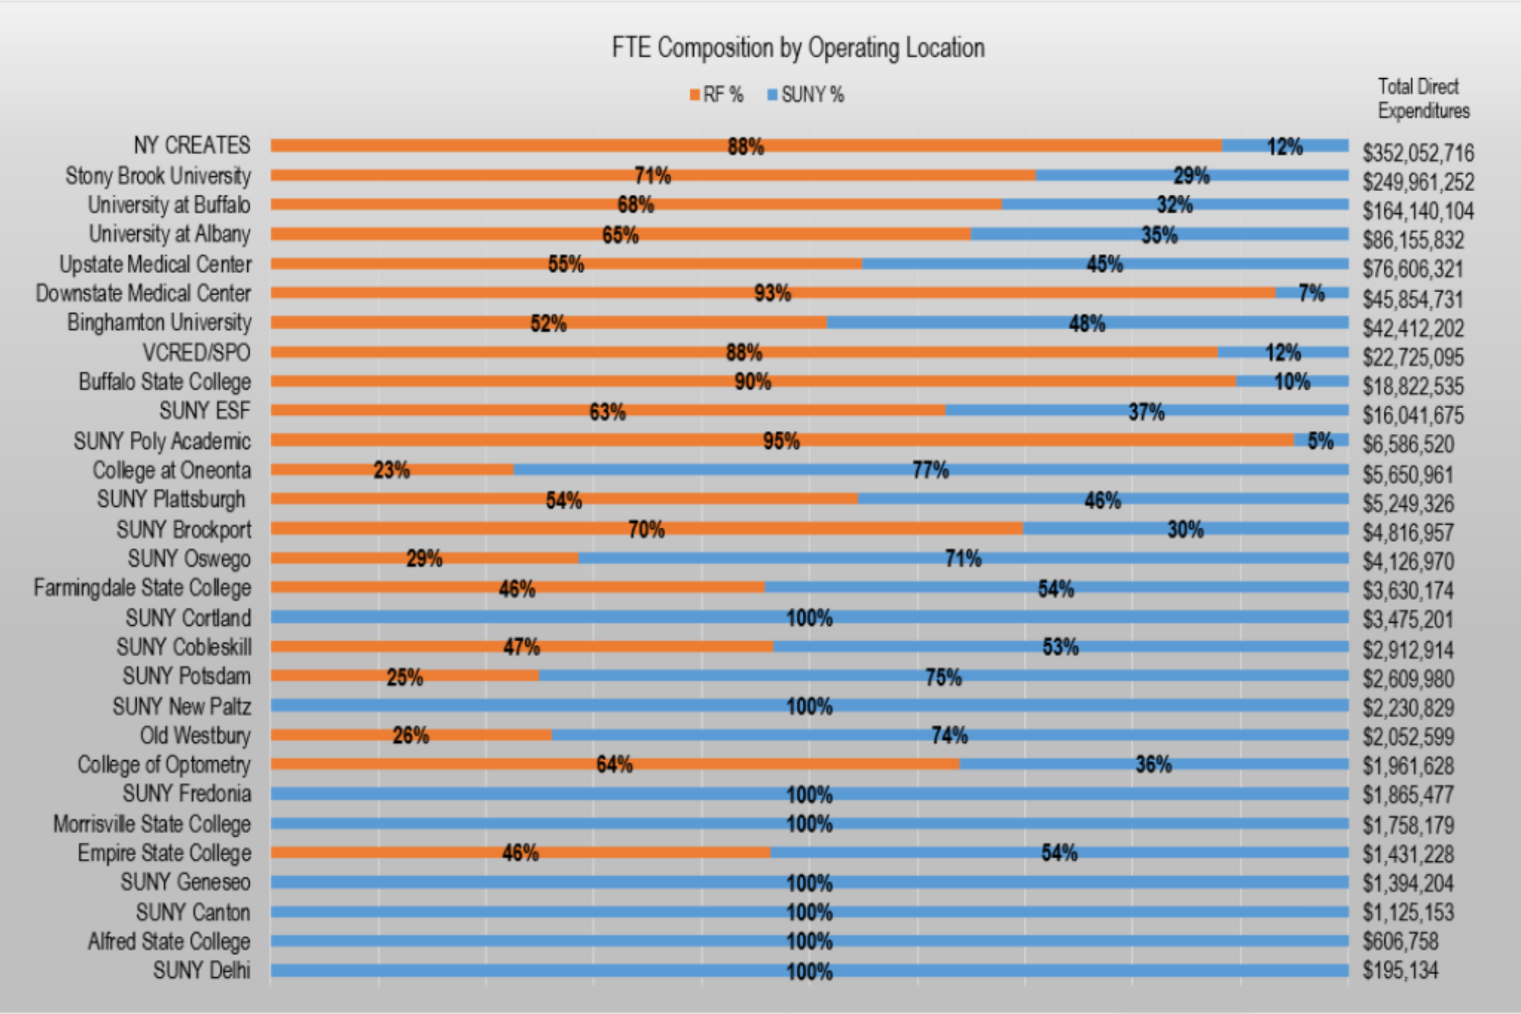
Current State: Benchmarking across SUNY

Slide 5
What We Learned
Comparison of SBU & UB Activity Level
Office of Sponsored Programs and Office of Grants Management
Institution | FTE | RF Expenditures | $/FTE
U. Buffalo | 41 | $164 M | 4.0 M
Stony Brook | 37 | $249 M | 6.7 M
Expenditures 50% higher, staff 10% lower than UB
→ burden per FTE at SBU 70% higher than UB
→ would require 62 FTE (+25 FTE) for parity with UB

Slide 6
Data on Office of Proposal Development (OPD)
OPD Awarded Proposals (June 2016-June 2020)
Proposal Category | Award Direct Costs ($M) | Award Indirect Costs | Total Award Amount
Large/Complex | $ 50.6 M | $10.1 M | $60.8 M
Early Career | $ 5.7 M | $2.5 M | $8.2 M
Other | $ 2.6 M | $0.6 M | $3.2 M
Grand Total | $59.0 M | $13.1 M | $72.1 M
Annually, per Specialist:
$ 2.8M in new external award dollars
$ 525k in IDC earnings
Cost = $142k ($100k + $42k fringe)
IDC ROI = 3.7×

Slide 7
Recommendation: Add 8 FTE to support proposals and awards
Immediate Investments
1 FTE to OGM for HR matters (payroll forms, salary offset, cost share, effort reporting)
1 FTE to OGM as Facilitator for urgent /complex matters that span several post award offices (travel, accounts payable, human resources, etc.)
2 FTE to OPD for increased proposal development
Investments in Fiscal Year 2022
1 FTE to OSP for increased clinical trials contracts
1 FTE to OSP for broader support to individual PIs and post award actions
Investments by Fiscal Year 2023
1 FTE to OSP and 1 FTE to OGM for specialized subcontracts team to expedite outgoing subcontracts, including billing reporting and close-out

Slide 8
Cost/Benefit
Benefits
More competitive proposals → more research expenditures / more IDC
Reduced admin burden on faculty → less inertia to prepare proposals
Streamlined process, better sponsor compliance
Cost/Investment
One-time investment: 4 FTE
Ongoing: 2 FTE/yr ($300k/yr) over two additional years (8 FTE total, $1.2M/yr total)
Ease of Implementation
Moderate: requires initial investment for long-term return
3 – 6 months to start; complete in four (4) years
Negligible cultural risk; broadly accepted idea by campus

Slide 9
Implementation Considerations
No SUNY barriers to implementation
No internal rules/policies that would impact implementation
No internal resistance expected because new positions would improve current processes across the university
Return on investment will be continuously evaluated

Slide 10
Comparison with Strategic Growth FTE Requests
Total of 12 new FTE over three years

Slide 11
Questions

Slide 12
Data on OPD (Proposal Development)
OPD Count of Proposals by Category (June 2016-June 2020)
Proposal Category | Awarded | Pending | Declined | Total
Large/Complex | 23 | 31 | 45 | 99
Early Career | 15 | 12 | 103 | 130
Other | 5 | 9 | 8 | 22
Total | 43 | 52 | 156 | 251
Award rate for Large/Complex: 23%
Award rate for Early Career: 12%
WEIGHTED AWARD RATE: 17%
To date, in FY 2021, a total of 5 *new* proposals over $10M were submitted by SBU to external federal sponsors. OPD supported 4 of the 5.

Slide 13
Data on OSP, OGM, OPD
High-level Overview of Current Activity Level
Unit in OVPR | FTE | Volume of Activity
Sponsored Programs (pre awards) & Grants Management (post awards) | 37 | 2234 awards per year, 1600 proposals per year, $249M expenditures through RF per year, $190M of which are externally sponsored awards
Office of Proposal Development (proposal development team) | 5 | 50 proposals per year (20 large/complex over $3M; 30 early career)
Data source: Report Center, myResearch

Slide 14
OGM Benefits / Risks
Benefits:
Streamline processes that can be viewed as problematic by reducing the administrative tasks for researchers
Increase efficiency in OGM and between other departments (i.e., HR and Finance teams)
Provide critical centralized support for all personnel costs charged to sponsored awards
Provide strong internal controls necessary for sponsor compliance
Risks:
No expected risks from this recommendation

Slide 15
OSP Benefits / Risks
Benefits:
Increase volume of clinical trials contracts and increase the speed of contracts turnaround
Increase administrative support to individual PI proposals
Increase campus compliance with sub-award processes and greatly enhance researcher encounters with sub-awardees
Risks:
No expected risks from this recommendation

Slide 16
OPD Benefits / Risks
Benefits:
In the first year, the new specialists would each bring in $2.8M in new external award dollars and $525K IDC earnings. This increase is expected to continue annually.
Working with Proposal Specialists will significantly reduce the administrative work of the research team (PI, co-PIs, etc.).
Having centrally managed proposal development support provides an incentive for projects to align with institutional research priorities, making it more feasible to reach institutional research goals. It also provides a more consistent framework for the proposal development process, which improves the administration's reputation among internal researchers as well as external sponsors and stakeholders.
Risks:
No expected risks from this recommendation.

