Slide 1
Share Data Without Boundaries: Making Spreadsheets and Tables Accessible
Lindsay Bryde, MA, MFA
Course Content Accessibility Specialist
Center for Excellence in Learning and Teaching Specialist

Slide 2
Agenda
What We’ll Discuss Today
Why make data accessible?
Spreadsheets – Microsoft Excel and Google Sheets
Charts
HTML Tables
Figure 1. A poster with different icons representing accessibility concerns physically and mentally. This Photo by Unknown Author is licensed under CC BY

Slide 3
Why Make Data Accessible?
There are many benefits across fields and communities:
Ensures all individuals have equal access to information and opportunities.
Saves time and resources by making it easier to find, retrieve, and use data without needing special tools or accommodations.
Meets legal and regulatory requirements related to data accessibility and inclusivity (e.g., the Americans with Disabilities Act).
Figure 2. A magnifying glass over a pie chart.

Slide 4
Spreadsheets and Tables

Slide 5
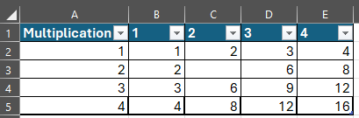
Best Practices
Figure 3. An Excel table with accessible and identified headers..
For Microsoft or Google
All tables need an identified header.
Name all tables and sheets to maintain
clarity and organization.
Screen readers begin at cell A1, always include content in this cell. It can be as simple as noting the title of the table, chart, or first column's header information.
Mark blank fields as “Blank” or “N/A.”
Delete empty sheets.
Insert images in cells (if it’s over the cells, a screen reader won’t know to read it).
Figure 4. An image inaccessibly placed over cells.

Slide 6
Inaccessible Practices to Avoid
For Microsoft or Google
Figure 5. An example of an inaccessible table with merged and split cells.
Merging, nesting, and splitting cells.
Controlling spacing with blank rows and columns.
Using tables for design layout.
Use MS Word or Google Docs instead.
Freezing or hiding rows or columns.
Header Row | Topic 1 | Topic 2 | Topic 3
Row 1
Row 2
Figure 6. A simple and accessible table.

Slide 7
Charts

Slide 8
Best Practices for Charts
For Microsoft and Google
Add Descriptive Titles and Labels:
Replace generic titles with meaningful ones. For example, a generic placeholder like "Chart Title" should be replaced with something specific like "Quarterly Sales Data."
Include Alt Text:
In a sentence or two, describe the purpose of the chart.
Create sufficient contrast between lines, bars, and shapes:
Remember to check all lines, bars, and shapes.
Figure 7. A chart with a descriptive title, labels for each section of the pie chart, and percentages noted.

Slide 9
HTML Tables

Slide 10
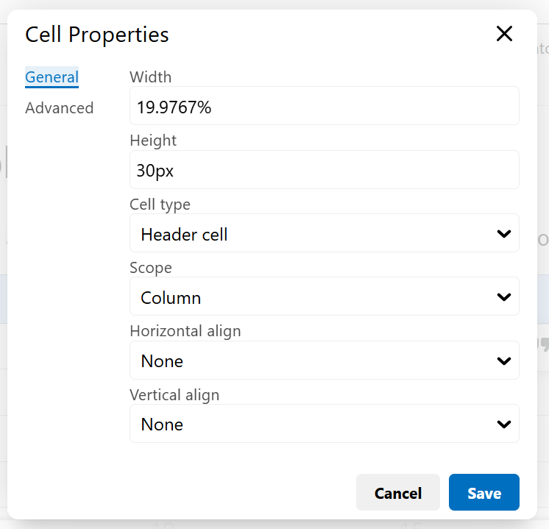
Best Practices for HTML Tables
If there’s an overall title to your table, provide it above/before the data on a separate row – don’t add it as a merged row above the headers.
Add the scope of each header row or column.
Provide captions to indicate the purpose of the data.
Note: you need to reset headers if copying and pasting a table from a file to Brightspace. Most header tags don’t copy over fully/correctly.
Figure 8. The Cell Properties pop-up open with the cell type and scope options that need to be set.

Slide 11
Questions?

