Slide 1
Data governance
The Key to Protecting the Things You Love
Notes:
THERESA
Brief rundown of data governance at SBU
Values
Structure/members
Some initiatives

Slide 2
Who we are
Data Governance dedicated employees:
Theresa Diemer - Assistant Director for Data Governance and Management
Arielle Markiewicz – Business Analyst for Data Governance
Visit us at:
stonybrook.edu/datagovernance
Email:
DATAGOVERNANCE@STONYBROOK.EDU
Notes:
THERESA
Agenda
Brief rundown of data governance at SBU
Values
Structure/members
Some accomplishments
Background of Data Governance at SBU:
Started in 2016 from the Project 50 forward Steering Committee’s initiative to improve SBUs data infrastructure.
Began meeting Spring of 2017 with 11 members
Original SCOPE- PS and Data Warehouse
Volunteers from various departments now Arielle

Slide 3
What is Data Governance?
Data governance refers to a set of policies, processes, roles, and standards established within an organization to ensure the quality, security, accuracy, and usability of data throughout its lifecycle, effectively managing data access, usage, and compliance with relevant regulations.
Notes:
Theresa
Foundation of what we are talking about today.
Data Governance as a concept ……….
Essentially, it's about managing how data is handled and used within the organization to be able to make informed decisions based on reliable information.

Slide 4
The foundation of data governance
Notes:
ARIELLE:
DESIGNATE DECISION-MAKING BODY: Facilitates the improvement of the university’s data infrastructure and advancements of institutional goals for operational excellence.
ESTABLISH EXPECTATIONS: Establish expectations for how the university’s administrative data is defined, produced, used, stored, and destroyed.
MAINTAIN DATA QUALITY: Develop and execute procedures and systems to maintain and improve data quality.
FORMALIZE BEHAVIOR: Formalize data dictionaries and descriptions of architecture. Designate individuals to provide stewardship. Maintain timelines for data quality checks.
IMPROVE USER LITERACY AND USAGE: Recognize and address data complexities users come across. Provide trainings and allow input from users to improve data literacy, usage and governance.
Why we love data governance
Why does stony brook love data governance

Slide 5
Shared Values of Data Governance
Shared Assets
Stewardship
Quality
Privacy and Confidentiality
Notes:
ARIELLE
Emphasize:
Data quality, and
Data protection
Shared Assets: Data and information are shared organizational resources that constitute valuable assets.
Stewardship: Employees have a responsibility for the curation of data, ensuring it's collected, stored, and maintained for future use.
Quality: Data quality is actively monitored and maintained to ensure it retains its value.
Making sure data is clean, accurate and complete
Privacy and Confidentiality: Maintaining individual privacy and confidentiality of records is a primary outcome of data management.

Slide 6
because of Data Governance
The university adheres to and enables institutional compliance with applicable statutes, regulations and policies
Documentation exhibits transparency which is available to the University community
Consistent standards for data elements, dictionaries, metadata, quality, and usages are identified and supported.
Responsibilities for cross-functional data-related decisions, processes, and controls are defined.
Documentation and verification of data and metadata, the tracking of changes and the justification for changes are promoted.
DATAGOVERNANCE@STONYBROOK.EDU
Notes:
ARIELLE:

Slide 7
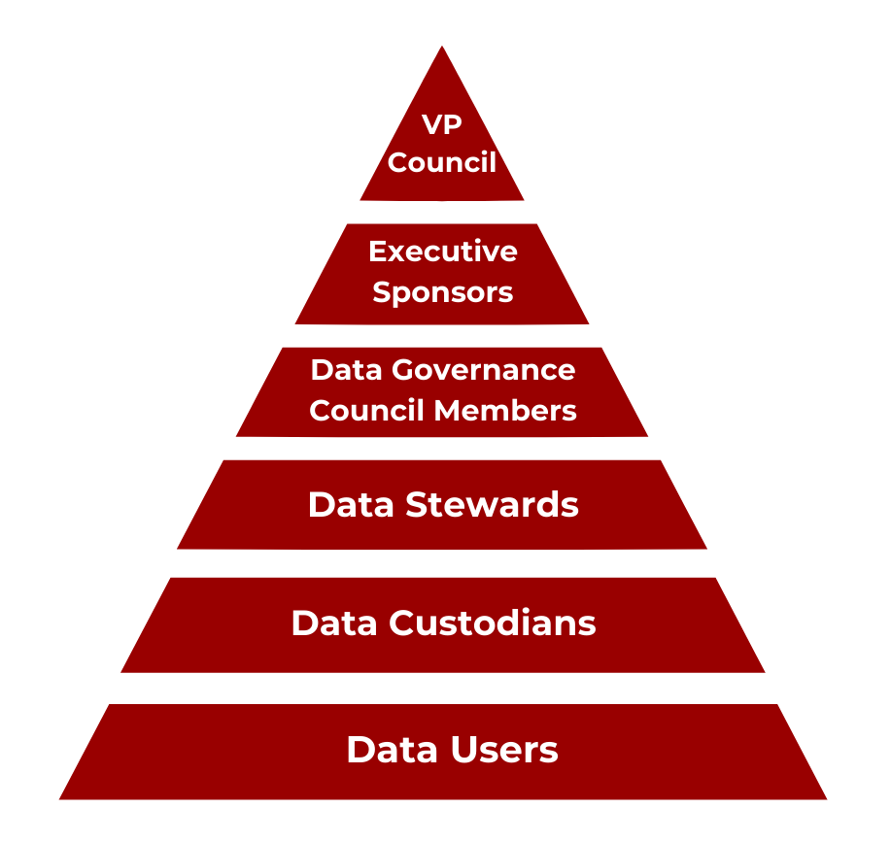
We are all in this together
Notes:
THERESA:
Data Governance structure at SBU.
VP Council at top
Executive Sponsors: set high level priorities and direction and report to VP council
Braden -Vice President for Educational and Institutional Effectiveness and
T. Simeon Ananou -Vice President for Information Technology and Chief Information Officer
Data Governance Council Members: VPs or representatives
Recommend and implement institutional policy for data governance of university administrative data
Set specific projects that the council will focus on
Communication campaign
Data disposition to protect university in case of breach
Guidelines for the appropriate use of data
Data Stewards:
develop, maintain, and manage policies and procedures for the data asset
Give feedback about issues needing attention
Data Custodians:
Implement and enforce security and access rules and policies; grant and remove access to specific users and/or data.
Data user:
accesses, analyzes, and uses data
Our goal is that it is: high Quality, accurate, and used correctly with in established parameters

Slide 8
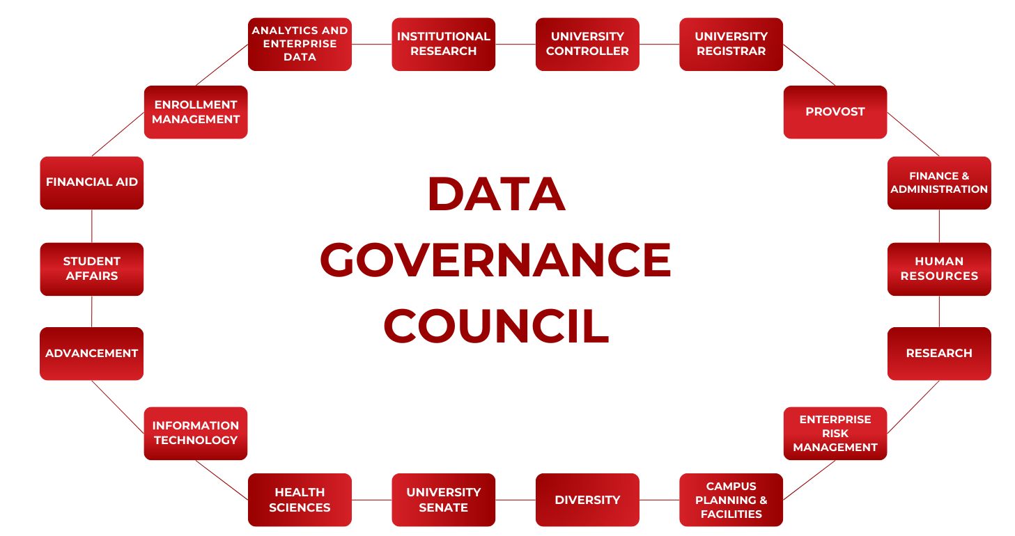
Dg council AREAs WE APPRECIATE
Notes:
The members we love
THERESA
Areas represented on the DG Council

Slide 9
The Dg council members
Braden Hosch, Vice President for Educational & Institutional Effectiveness, Executive Sponsor Simeon Ananou, Chief Information Officer, Executive Sponsor Kim Berlin, Analytics and Enterprise Data Officer, Chair Diane Bello, University Registrar, Co-Chair Ahmed Belazi, Student Affairs designee Andrew Kirsch, University Senate designee Cassandra Amadio, University Controller Christopher Martin, Campus Planning & Facilities designee David Cyrille, Health Sciences designee Jeff Mackey, Finance & Administration designee Vacant, Information Technology designee Judith Brown Clarke, Chief Diversity Officer designee Kara DeSanna, Provost’s Office designee Marrisa Trachtenberg, Enterprise Risk Management designee Nicholas Prewett, Chief Financial Aid Officer Richard Beatty, Chief Enrollment Management Officer Rob Miller, Chief Institutional Research Officer Robert Davidson, Research designee Susan Agro, Advancement designee Tracey McEachern, Human Resources designee Theresa Diemer, Assistant Director for Data Governance and Management, ex officio Arielle Markiewicz, Data Governance Business Analyst, ex officio
DATAGOVERNANCE@STONYBROOK.EDU
Notes:
THERESA

Slide 10
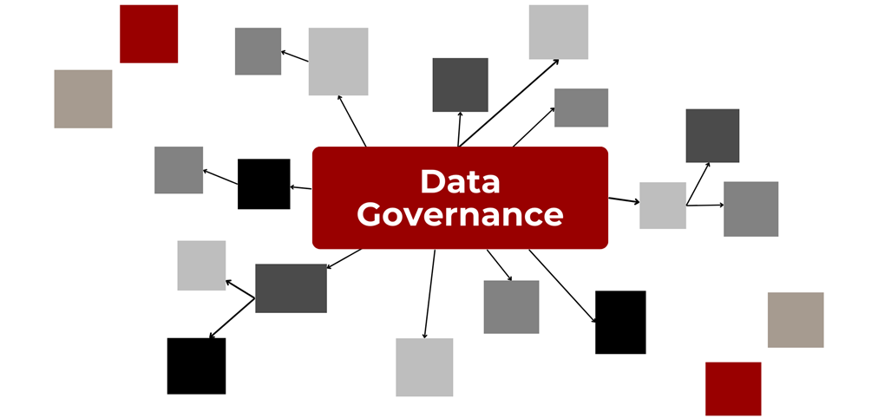
Everything’s connected
https://www.stonybrook.edu/commcms/datagovernance/
Notes:
THERESA
Website dedicated to Data Governance (formerly on IRPE website)
Go to webpage
Highlights of year

Slide 11
Report standards
https://www.stonybrook.edu/commcms/datagovernance/structureandroles/report_standards.php
Notes:
The Data Governance Council is charged with establishing standards for university reports that make use of the data under its purview. Report standards have been developed to promote clear communication about data and to empower data users to meet their responsibilities to:
2a. recognize that institutional data and information derived from it are potentially complex. Make efforts to understand the source, meaning and proper use of the data through training sessions, utilizing data dictionaries and knowledge of supporting system processes; and 2b. include information about the data source and criteria when distributing data, reports and ad hoc analytics to guard against misinterpretations of data.

Slide 12
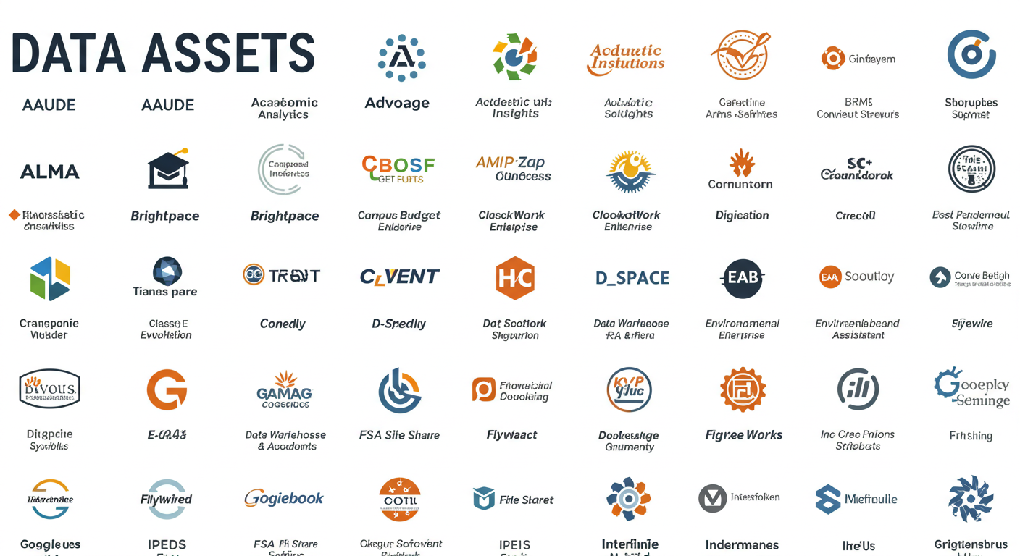
https://www.stonybrook.edu/commcms/datagovernance/resources/DataAssets.php
Notes:
Data Assets are information-based resources, comprised of University Data, including repositories, systems, and services.
Brightspace, file share with survey results - yes
Photoshop or zoom- not- while it is an application it does not store university data.
Data Trustees: Senior leaders who have the ultimate responsibility for designated data assets
The new Policy on Data and Data Access requires each data asset to have DATA ACCESS Management procedures which document how users may access data.
See stonybrook.edu/policy
Full list : https://www.stonybrook.edu/commcms/datagovernance/resources/DataAssets.php
To access the Data Asset Inventory, users must log in via SSO/NetID.
Please let us know about New assets or assets not previously identified

Slide 13
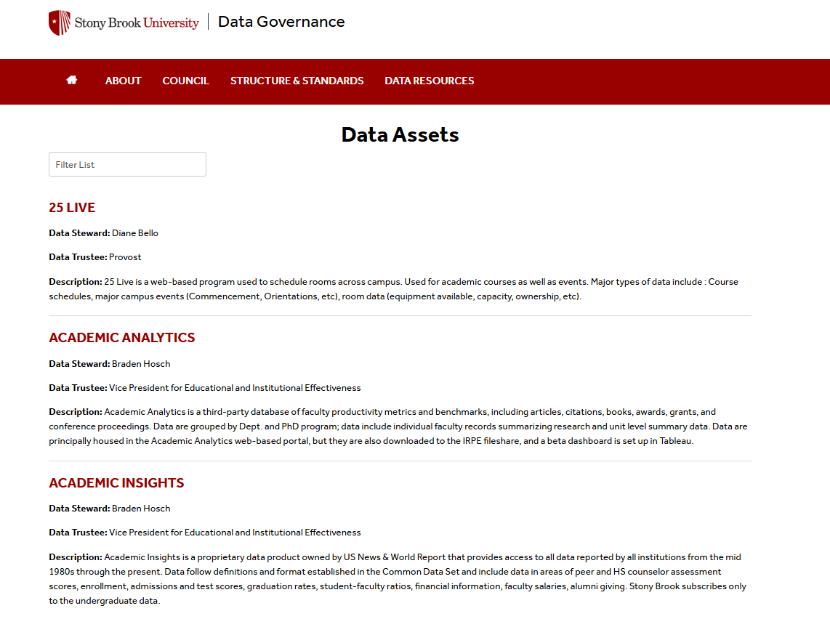
Data asset inventory
An Employee Access only webpage within our Data Governance website.
Notes:
THERESA
Go to DATA Cookbook

Slide 14
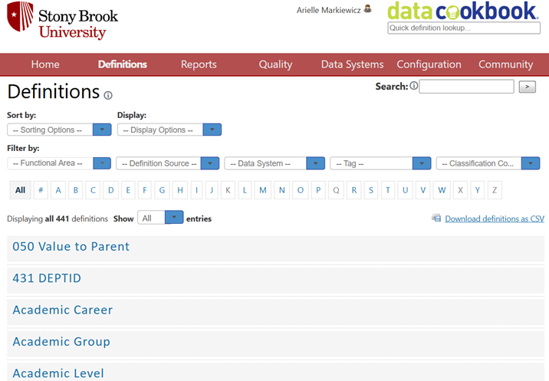
Data definitions
Designed to promote communication and production of meaning
Document the existence, meaning, and use of data elements.
Data dictionary standards can be found on our Data Governance website
Data Cookbook
A metadata management tool
Provides a digital repository for data definitions and other metadata
Can be integrated with existing reporting and analytics.
To access the Data Cookbook, users must log in via SSO/NetID.
https://stonybrook.datacookbook.com/
https://stonybrook.datacookbook.com/
Notes:
ARIELLE

Slide 15
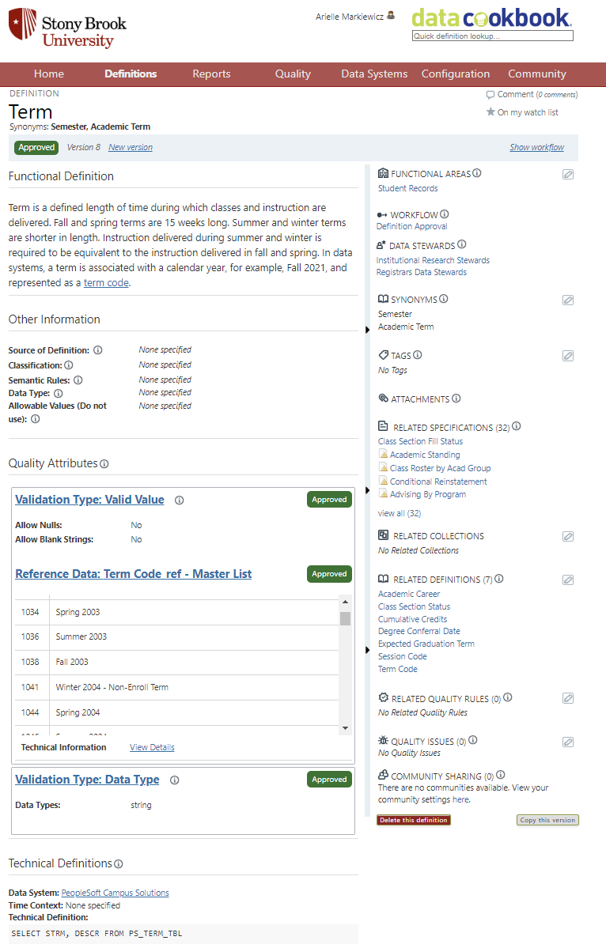
Field name
Definition
Functional area
Synonyms, Also known as, etc…
Reports can group definitions, and link into Tableau dashboards
Pulls in examples of field values
Definitions that mention this field, or fields that are mentioned in this field’s definition
Information on this field’s source, SQL code for pulling the data
Notes:
ARIELLE

Slide 16
Looking towards a shared future
Data Governance and AI
How Data Governance intersects with Data Protection, Data Security, and more
Finding the balance between Governance and efficiency
Increasing knowledge about Data Governance and how it can benefit all of us
DATAGOVERNANCE@STONYBROOK.EDU
Notes:
THERESA

Slide 17
Thank you
stonybrook.edu/datagovernance
DATAGOVERNANCE@STONYBROOK.EDU

