Slide 1
University Senate
Charles L. Robbins
Vice Provost for Undergraduate Education and Student Success Dean of the Undergraduate Colleges Executive Director Center for Changing Systems of Power

Slide 2
Overview
Leadership & Academic Success Team
Graduation & Retention Rate Improvements
Student Success: Strategy and Programs
Executive Leadership | Academic Success Team
Male Student Completion
What the data show us
Value proposition | Geography | Programs
Problem | Strategies

Slide 3
Leadership and
Academic Success Team

Slide 4
Executive leaders prioritized student success
President Stanley participated in the White House Conference in January 2014 and announced that we would achieve a 60% 4-year graduation rate by 2020
While we embraced the challenge – we understood it would be a stretch goal!

Slide 5
Broad-Based Academic Success Team
Goals
Improve student outcomes
- Retention
- 4-Year graduation rate
Values and approach
Student-centric
Improve quality of undergraduate experience
Data-informed
Evidence-based practices
Predictive analytics
Public health/population health model
Systematic 360 degree review
All policies and procedures affecting student success
Broad Representation
Vice Provost UG Ed.
Advising (all units)
Bursar
Career Center
Deans Offices
Enrollment Mgmt.
Finance
Financial Aid
Information Technology
Institutional Research
Orientation
Registrar
Special Programs
Student Affairs
UG Colleges

Slide 6
PDSA Cycle for
Learning and
Improvement
Act
Plan
• What changes
are to be made?
• Objective
• Questions and
predictions (why)
The Plan, Do, Study, Act model developed by Arthur Deming (1950) and incorporated into quality improvement across many industries including health care and education is the basis for Academic Success Team activities.
• Next cycle?
• Plan to carry out cycle
(who, what, when, where)
• Plan for data collection
Study
Do
• Complete the analysis
of the data
• Carry out the plan
• Document problems
and unexpected
observations
• Compare data to
predictions
• Summarize what
was learned
• Begin analysis
of the data
Notes:
Graphic source: http://www.ihi.org/resources/Pages/ImprovementStories/QandAonQISixQuestionsForIHIImprovementAdvisor.aspx

Slide 7
Graduation & Retention Rate Improvements

Slide 8
Freshman graduation rates increased seventeen percentage points in the last six years
17
Percentage point increase
in 4-yr grad rate over 6 years

Slide 9
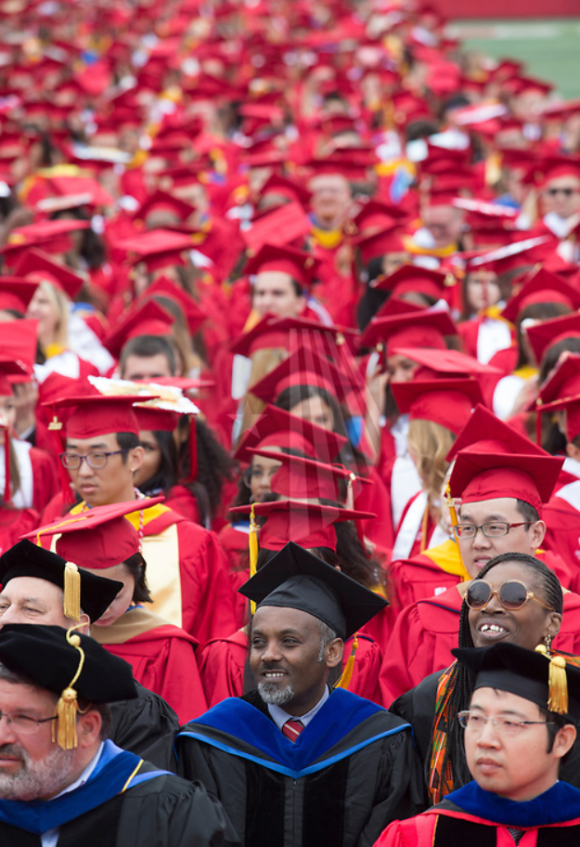
Economic benefit to students
1,800 additional students graduated on time
$125 million
economic benefit to students
$24 million saved in tuition & fees
$101 million in additional earning capacity

Slide 10
Equity gaps in graduation rates are largely closed
Source: IRPE FT FT grad rate data set v.33; 6 yr rates match data reported to IPEDS, 4 yr rates are preliminary until reported to IPEDS in 2021 and 2022.

Slide 11
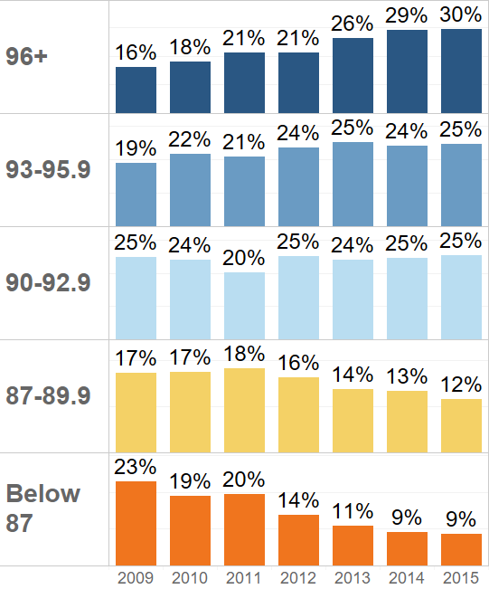
Systemic improvement and higher academic profile contributed to the graduation rate increase
HS GPA
Percent of cohort
12%
of increase attributable to systemic improvement
5%
of increase attributable to higher academic profile
Source: IRPE FT FT grad rate data set v.33. HS GPA is the best pre-college predictor of graduation rates. Effect of high profile estimated as graduation rate for each GPA band for entering class in 2009 applied to proportion of entering class in 2015.

Slide 12
Student Success Programs

Slide 13
Improvements realized through multi-pronged approach
Academic Success Team
Inst. Research
- Expansion
- New mission
Analytics
- In-house
-3rd-party
Academic Success and Tutoring Center
Policy reform
- Class retake
- Registration expectations
Finish in Four
- Mini grants
- Student-facing app
Segmentation
- Men
- GPA 2.0-2.5
- Behind in credits
Advising
- Expansion
- Focus on 3rd & 4th yrs.
Courses
- Class availability
- High DFW classes
-UGPD Meeting
Notes:
Special populations:
State scholarship recipients
Juniors and seniors, esp. when behind in credits
Men

Slide 14
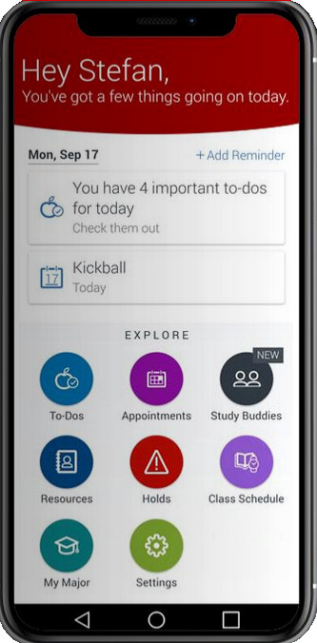
Finish in Four Initiative
Class Advisors
Advisors to students in 3rd & 4th years improved retention after the 2nd year and on-time graduation
Mini-Grants
Mini-grants are made to seniors with unexpected financial need and a clear path to 4-year graduation
Student Mobile App
Provides students with reminders, real-time alerts, and planning tools
98%
Success Rate

Slide 15
Programmatic Initiatives
Hybrid Advising Model
Undergraduate Colleges | Academic and Transfer Advising Center
CEAS Student Services | Academic Departments
Educational Opportunity Program/
Advancement on Individual Merit
University Honors Programs
- Honors College
- University Scholars
- WISE
Navigate Platform
Pop-up Advising
Student Success Website

Slide 16
Academic Success and Tutoring Center
One-on-one and small group course-based tutoring, one-on-one skill-based tutoring, peer assisted learning (Supplemental Instruction), and public speaking courses
The Peer Academic Success Coaching (PASC)
Star-NY Online Tutoring Service - Sunday - Thursday from 7pm - Midnight (last login is 11:30pm)

Slide 17
The Missing Men
At Graduation

Slide 18
Four-Year Graduation Rates by Gender
Gender Gap
2006*
17%
2019**
10%
* Freshman entering in fall 2002
** Freshman entering in fall 2015

Slide 19
Issues that emerged from the literature review/focus groups/interviews
Masculinity/Toxic masculinity & higher education
Emotional and developmental readiness – frontal lobe
Lack of focus
Inadequate academic preparation

Slide 20
Issues that emerged from the literature review/focus groups/interviews
Inability to deal with frustrations
Inability to delay gratification
Financial realities of higher education
Never previously experienced anything close to failure

Slide 21
Issues that emerged from the literature review/focus groups/interviews
Impact of alcohol and drug usage
Immersive video games
Inability and unwillingness to ask for help
Poor decision making

Slide 22
Who is a role model for what it means to be a full-hearted man in the 21st Century?

Slide 23



Slide 24
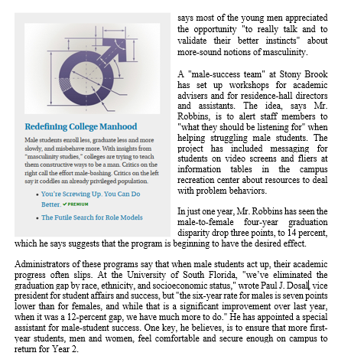
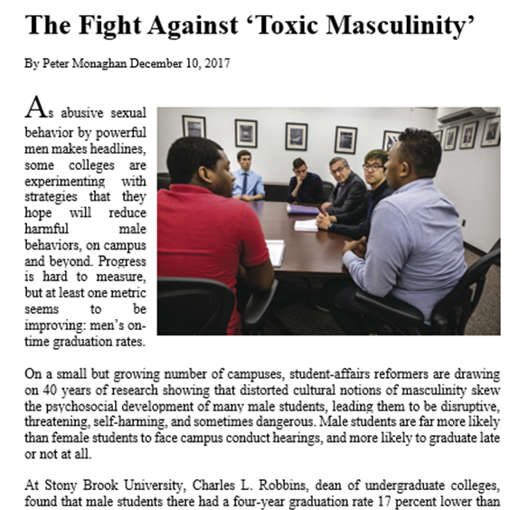

Slide 25
Conclusions
Achievements
17 point increase in 6 years
Improvement is in top 3 pct of 4yr institutions
Full-Court Press
Senior leadership commitment
Most equity gaps closed
Implemented any initiative we could identify
Lessons learned
Change requires sustained effort
Annual investment of hundreds of thousands of dollars
No magic bullets
Telling the story of “1001 Initiatives” presents challenges
High tech/high touch

